Slide 1
Angular
Routing and HTTP
Lecture 5
By James(Jin) Wang
09/01/2019

Slide 2
Outline
HTTP
RxJS, Observables, and Subscriptions
Async Pipe
Promises

Slide 3
HTTP
  We use HTTP to get and save data with Promises or Observables.
  We isolate the HTTP calls in a shared Services.

Slide 4
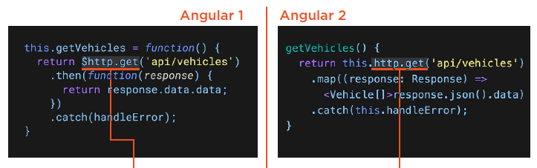
HTTP
  HTTP then and now:
  Demo: Needs HTTP

Slide 5
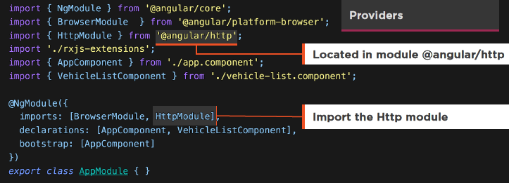
HTTP
  HTTP Requirements:
  We need the HttpModule to make HTTP calls

Slide 6
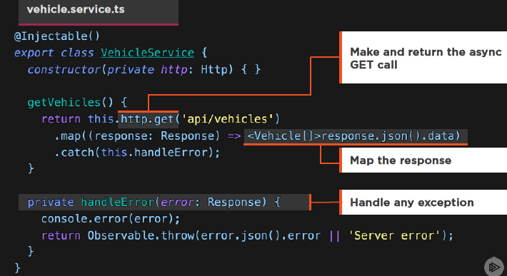
HTTP

Slide 7
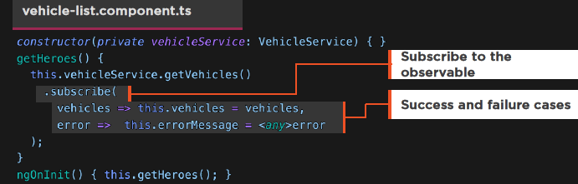
HTTP
  Subscribing to the Observable:
  Component is handed an Observable
  We Subscribe to it

Slide 8
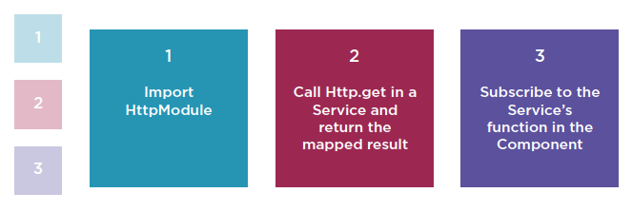
HTTP
  HTTP Step by Step:
  Demo: HTTP

Slide 9
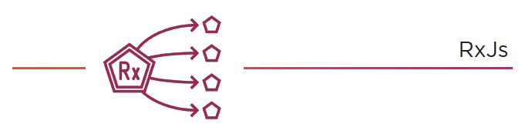
RxJS
  RxJS (Reactive JS) implements the asynchronous observable pattern and is widely used in Angular 2

Slide 10
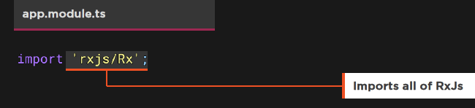
RxJS
  Importing RxJS:
  RxJS is a large library
  For production, only import the modules you require

Slide 11
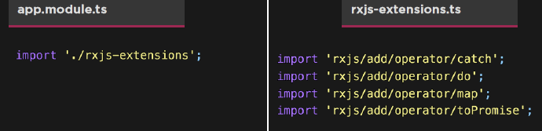
RxJS
  Prefer importing only what we use from RxJS

Slide 12
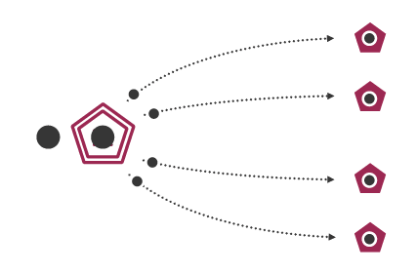
RxJS

Slide 13
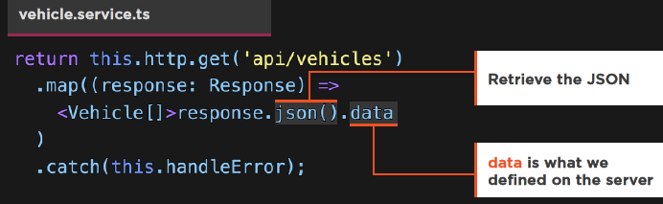
RxJS
  Returning from HTTP:
  We don’t return the response
  Service does the work
  The consumers simply get the data

Slide 14
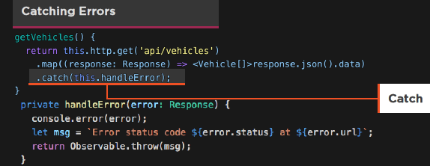
RxJS
  Exception Handling:
  We catch errors in the Service
  We pass some error messages to the consumer for presentation

Slide 15
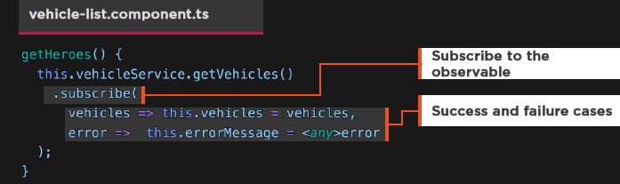
RxJS
  Subscribing to the Observable:
  Component is handed an Observable
  We Subscribe to it
  We can handle errors here, for presenting to the user if we wish

Slide 16
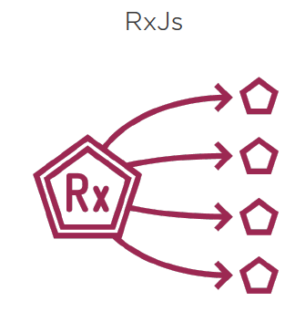
HTTP

Slide 17
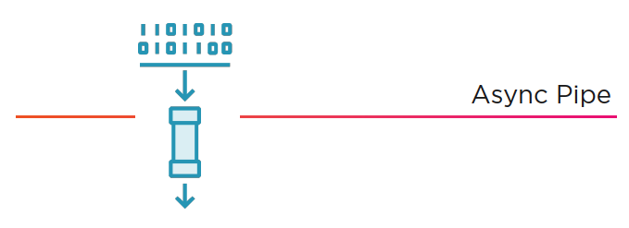
Async Pipe
  The Async Pipe receives a Promise or Observable as input and subscribes to the input, eventually emitting the values as changes arrive.

Slide 18
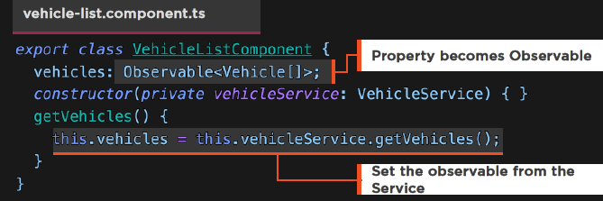
Async Pipe
  Observable Properties:
  Component is simplified
  Grab the Observable and set it to property

Slide 19
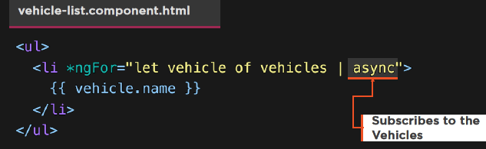
Async Pipe
  Async Pipe in the Template:
  Apply the async Pipe
  Demo: HTTP with Async Pipe
  Demo: HTTP with Promise

Slide 20
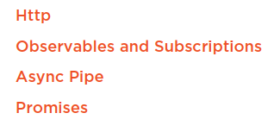
Summary

